Slide 1

Kickstarting Web Development
By: Anjali Sharma (Genzyug)

Slide 2

Class Instruction
I’ll explain one slide at a time
If you have any doubts, type them in the chat
After each slide, I’ll ask if it’s clear
I’ll solve doubts related to that topic
Please be interactive by giving answers of question I ask <3

Slide 3
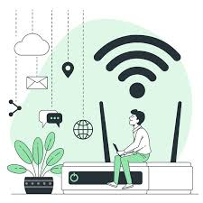
What is the Internet?
Internet = Global network of computers
Invented for communication between devices
Uses TCP/IP protocol
IP Address
ISP (Internet Service Provider)

Slide 4
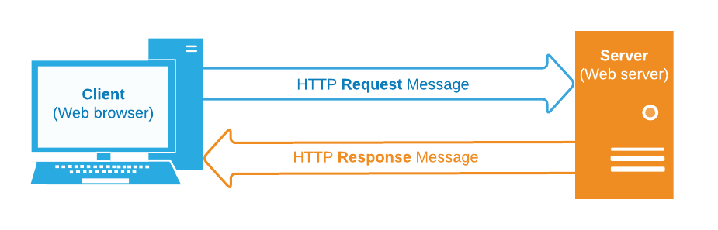
How Web Works
You type a URL
DNS resolves IP
Request sent via HTTP
Server responds with HTML/CSS/JS
Browser renders it

Slide 5

What is a Website?
A collection of web pages.
All pages are linked and accessed via a domain name (address)
stored on web servers.
Built using HTML, CSS, JS, and other technologies.
Domain Name + Hosting (upload it to a server. )= Website Live
Ex: Renting corner in mall
Popular hosts : GitHub Pages, Netlify, Hostinger

Slide 6
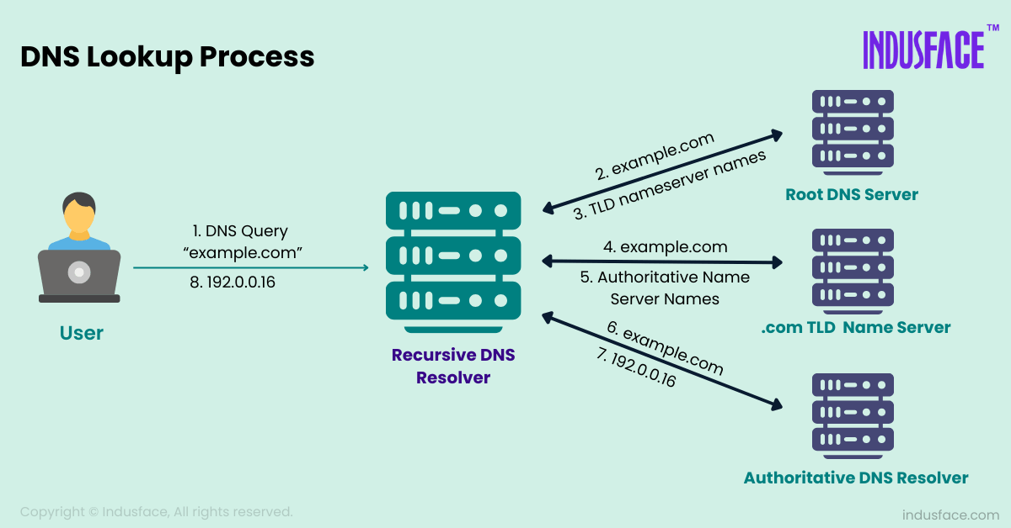
Domain Name System (DNS)
Translates domain names into IP addresses. (like Phonebook)
Helps your browser find the correct server.
Every website has an IP address, but we use names
(like Google.com → 142.250.190.78 )

Slide 7
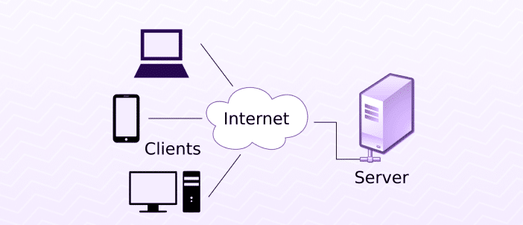
Client-Server Architecture
Client: Sends requests
(like a Chrome, Firefox, Safari browsers).
Server: Processes requests, sends responses.
(powerful computer & always online )
They communicate over the internet using HTTP (HyperText Transfer Protocol). /HTTPS (data is encrypted)
Real Life example : Restaurant

Slide 8

Setting Up VS Code
Go to https://code.visualstudio.com
Click on Download for Windows (or Mac/Linux as needed)
Open the installer file and follow the setup steps
(Next → Next → Finish)
Install Extension : Live Server (Optional)

Slide 9

Internet
Website
Browser/Server
DNS
Hosting
Client-server architecture
Q&A …..

Slide 10

Thank you
Revise the topics that we learnt today !!
All the best …

